Slide 1
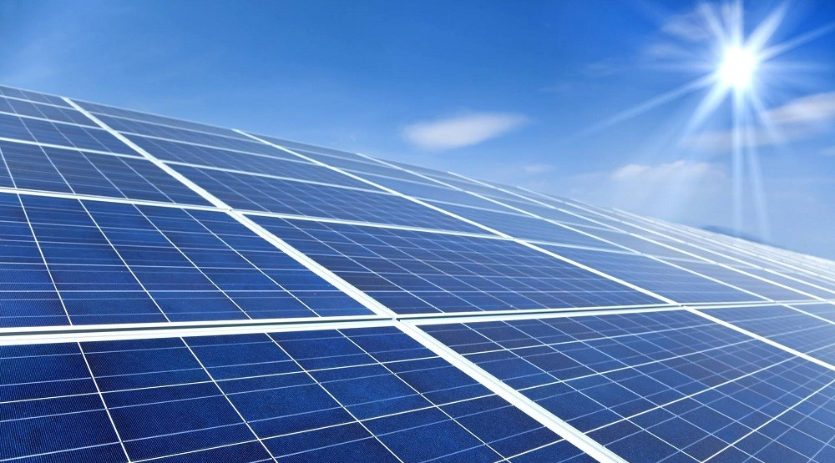
Solar Power Plant design
Lecture – 19 : Pvsyst

Slide 2
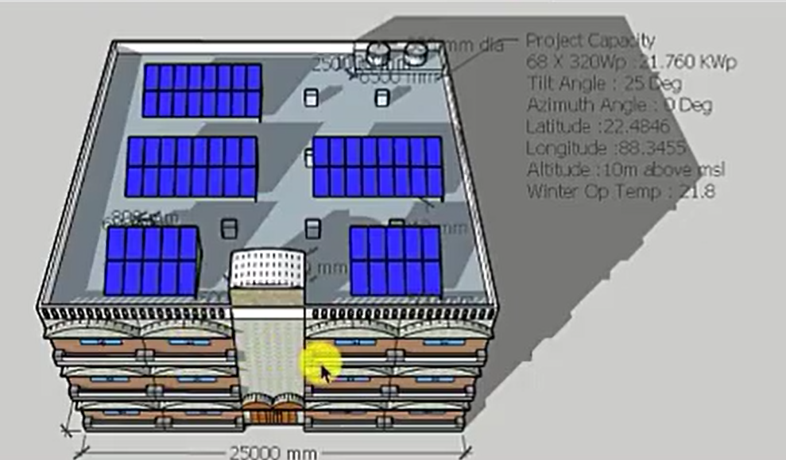

Slide 3


